Slide 1


IBM Course Seven
Week Three

Slide 2
Objectives
01
02
03
Apply Python exploratory data analysis techniques
Describe why and how to apply the chi-Squared Test
Implement descriptive statistics

Slide 3
Exploratory Data Analysis
EDA is an approach to analyzing data sets. The goal is to summarize their main characteristics with visual methods. It is used to discover patterns and anomalies, to test hypotheses, and to check assumptions.

Slide 4
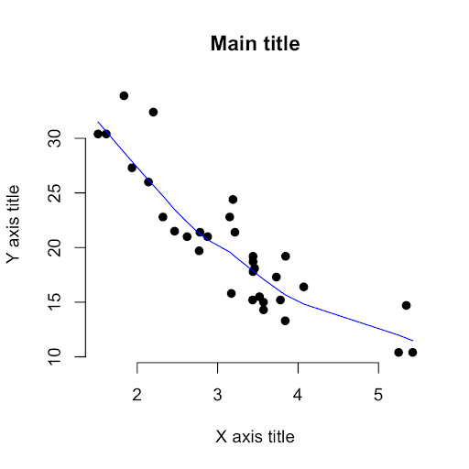
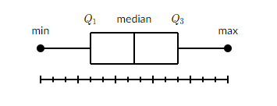
Descriptive Statistics
Descriptive stats describe the basic features of data by giving short summarize about the sample and measure of the data.
You can summarize statistics using pandas describe() method.
You can summarize the categorical data by using the value_counts() method.
Box plot 🡪method for graphically depicting groups of numerical data through their quartiles: minimum, first quartile, median, third quartile, and maximum.
Scatter plot 🡪 uses dots to represent values for two different numeric variables. They are used to observe relationships between variables. There are 3 possible correlations: positive, negative, and no correlation. n

Slide 5
35, 29, 34, 25, 29, 28, 38, 37, 35, 30
What are the steps you would take prepare the data to be visualized in a box plot?
Notes:
Step One 🡪 order the data from smallest to largest
Step Two 🡪 find the median
Step Three 🡪 find the quartiles
Step Four 🡪 complete the five-number summary by finding the min and max

Slide 6
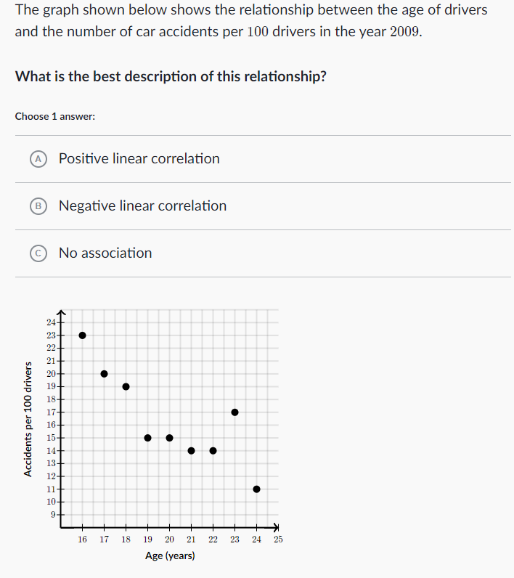
Practice!
Here’s a video if you get stuck.
Notes:
Answer: negative linear relationship

Slide 7
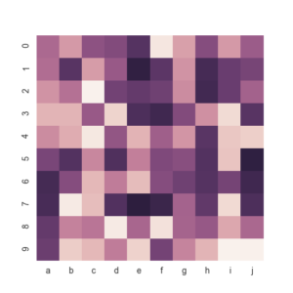
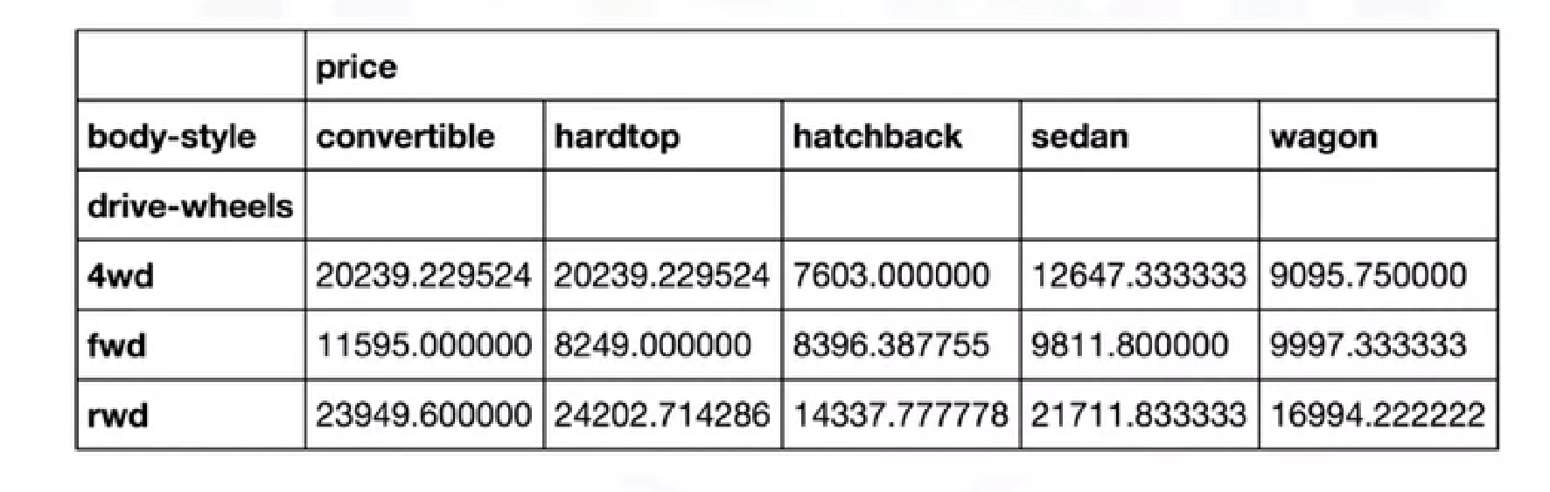
GroupBy is a function used to split data into groups based on specific criteria.
Pivot Tables
Heatmap Plot
Notes:
Pivot Table 🡪 one variable displayed along the columns and the others displayed along the rows.
Heatmap plot 🡪 graphical representation of data where the individual values contained in a matrix are represented as colours. It is important to pick relevant colours! Colour intensity is based on value.

Slide 8
Correlation
Correlation is a statistical metric for measuring to what extend variables are interdependent.
Correlation DOES NOT IMPLY causation.
What is the difference between correlation and causation?
Positive linear relationship
Negative linear relationship
No relationship
Notes:
Correlation = there is a relationship
Causation = one variable causes the other

Slide 9
Correlation – Statistics
Pearson Correlation 🡪 gives you two values: the correlation coefficient and the P-value.
Correlation coefficient 🡪 -1 – 1
P-value 🡪 0.0001 – 0.1
Notes:
Correlation coefficient 🡪 values closer to 1 imply a large positive correlation whereas values closer to -1 imply the opposite.
P-value 🡪 values less than 0.001 strong certainty; 0.05 moderate certainty; 0.1 weak certainty; more than 0.1 no certainty in the result

Slide 10
Chi-Square
Shows a relationship between two categorical variables
Does NOT tell you what kind of relationship exists between both variables; it only indicates whether there is a relationship.
Watch the video linked above in your Scrum groups. Take notes while you watch. Use those notes to fill in gaps in your Coursera notes. Then, write out a 5-10 sentence summary of what a Chi-test is and how and why it is used. If you can explain it to someone else, you understand it!

Slide 11
Labs and Assessments
Take the next 2 hours to work through the lab and the quiz for Course Six Week 3. Don’t forget to use the lab to test different commands and practice all concepts touched upon so far!

